Slide 1

Impaling Clips for Acoustic Panels
Cangzhou Futong
www.cangzhoufutong.com
A No.6 Fengxiang.Nanpi Industry Area.Hebei.China
Z 061501
E info@cangzhoufutong.com
​​​​​​​W www.czfutong.com www.cangzhoufutong.com

Slide 2
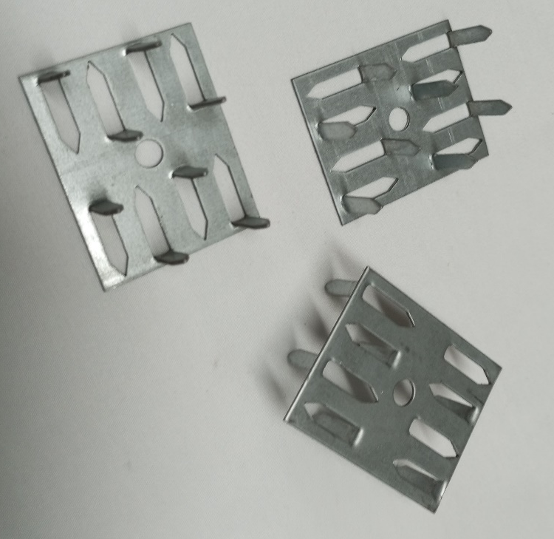
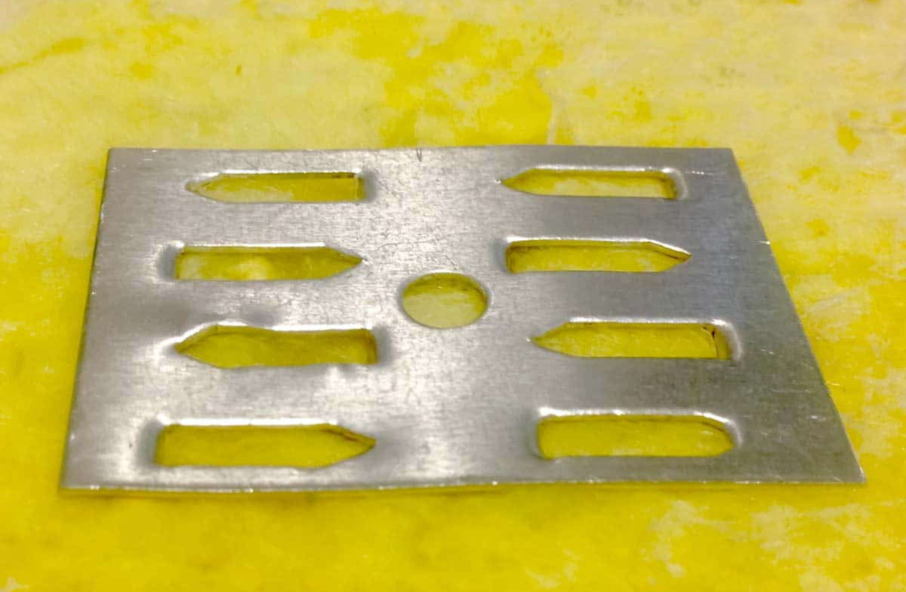
Impaling Clips for Acoustic Panels
Impaling Clips for Acoustic Panels
Cangzhou Futong Impaling Clips are designed for the quick and secure installation of fiberglass acoustic panels (703 / 705 Board) onto walls.
Each clip features 8 sharp spikes that firmly grip the panel’s fiberglass backing, holding it securely in place without the need for complex mounting systems.
Product Features:
Item NO:TN543801
Dimensions: 2-1/8" × 1-1/2", Depth: 5/8"
Material: Galvanized Steel
Design: 8-prong impaling clip with center mounting hole
Installation:
Mount directly to the wall using one drywall screw (not included), or
Attach with construction adhesive (e.g., Multi-Seal 180)
Recommended Use:
Use 4–6 clips per standard 2' × 4' panel
Position one clip in each corner for optimal stability
For installations requiring an air gap, add wood spacer blocks between the clips and the wall

Slide 3
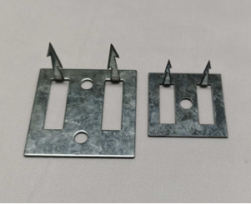
Impaling Clips for Acoustic Panels
Impaling clips are specially designed for quick, easy, and secure installation of polyester acoustical wall and ceiling panels.
They provide a clean, tool-free mounting solution that firmly anchors acoustic panels to any flat substrate, such as drywall, concrete, plywood, or other building surfaces.
Each clip features sharp, precision-formed prongs that penetrate into the back of the panel, ensuring a solid, long-lasting hold without visible fasteners.
Made from heavy-duty galvanized steel, our impaling clips offer superior corrosion resistance, rigidity, and durability for both residential and commercial acoustic applications.
Specification | TN505001 | TN383801
Overall Size | 2″ × 2″ (50 × 50 mm) | 1.5″ × 1.5″ (38 × 38 mm)
Material | 1.5 mm Galvanized Steel | 1.0 mm Galvanized Steel
Spike Configuration | 2 Spikes, 1″ long | 2 Spikes, 0.76″ long
Fastener Hole Diameter | Ø 6.3 mm | Ø 6.3 mm
Packaging | 500 pcs/box | 1000 pcs/box
Recommended Panel T | 1″ or 2″ panel | 1″ panel

Slide 4
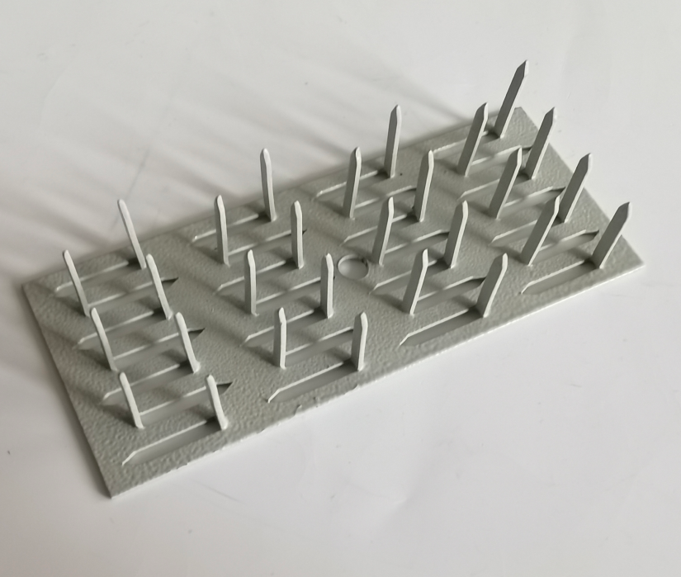
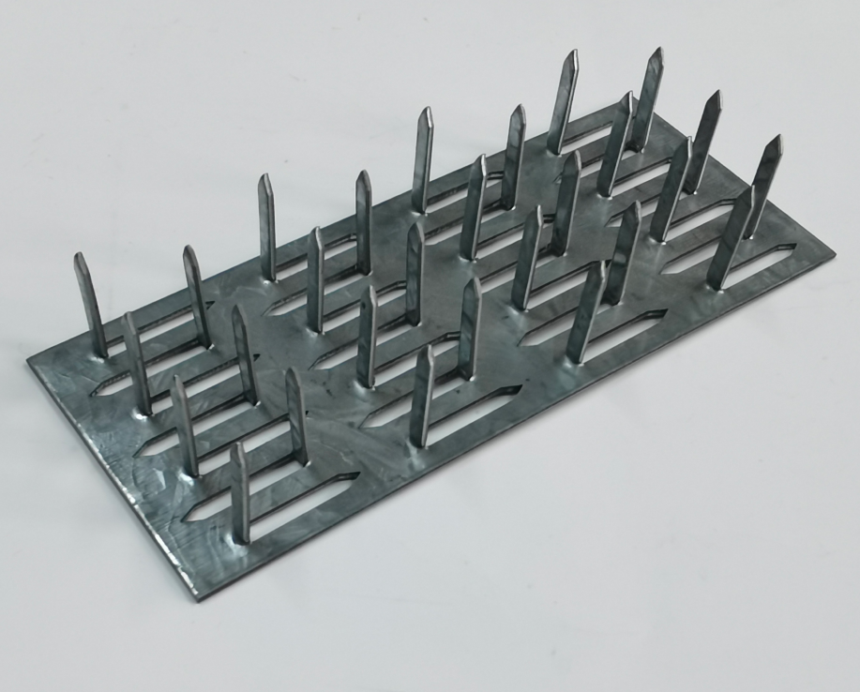
Large Impaling Clips TN12050201
Impaling Clips simplify the installation of rigid fiberglass acoustic panels. Use screws to fasten the impaling clip to the surface, apply PolyFoam Adhesive on the clip and acoustic panel then press the fiberglass panel to the clip.
Product Features:
Applications:
DIY acoustic panel installation
Fiberglass acoustical panels
Specification | TN12050201 | TN12050201P
Overall Size | 120x50x20x1.2mm
Material | 1mm Galvanized Steel | 1mm Steel
Spike Configuration | 28 Spikes, 20mm long
Sureface | Galvanized Steel | Powder Painting
Recommended Panel T | 1″ or 2″ panel

Slide 5
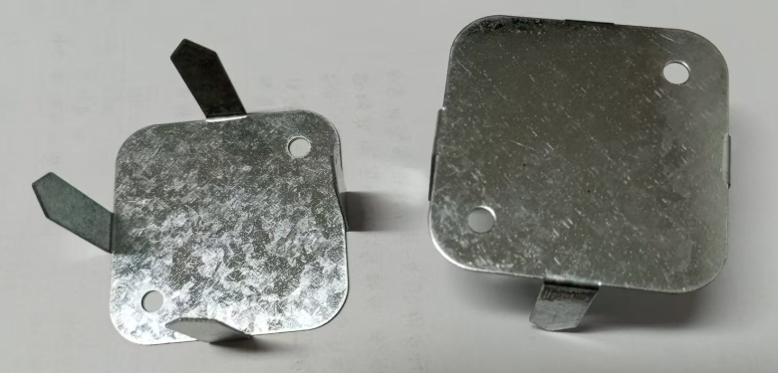
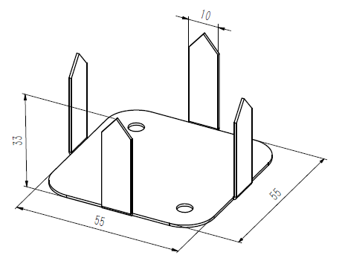
Wall Impaling Spikes
Impaling Clips for Wall Acoustic Panels
Product Features:
Item NO:TN553301
Dimensions: 55W× 55D × 33H(mm)
Material: Galvanized Steel
Design: 4-prong impaling clip with 2 mounting hole
Achieve a safe and effortless installation of your wall acoustic panels with our premium impaling clips.
Precisely engineered for a secure and reliable hold, each clip features sharp spikes that firmly penetrate the back of the panel, ensuring a strong, lasting connection to the wall.
Whether you’re mounting a single panel or an entire wall, these clips keep your panels perfectly aligned—maintaining both acoustic performance and visual appeal.
Simple to install with screws, they’re ideal for users needing extra clips beyond the standard supply.
With our impaling clips, you can confidently install and secure your panels for durable, professional-quality results every time.

Slide 6
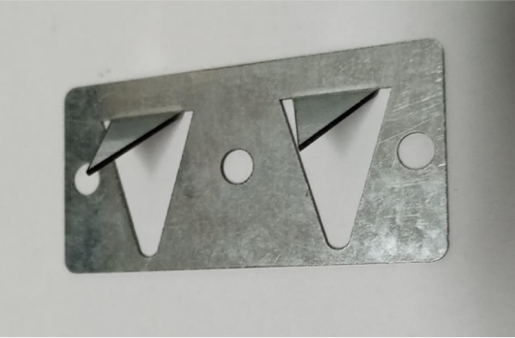

2-Prong PushDown Acoustic Impaler Clips
2-Prong PushDown Impaler Clips for Acoustic Panels
Our 2-Prong PushDown Impaler Clips provide a quick and reliable way to install acoustic panels directly onto walls—without the need for adhesive.
These heavy-duty clips are designed to securely hold panels made of fiberglass or mineral wool, ensuring a stable and lasting installation.
Product Features:
Item NO:TN763801
Dimensions: 3"W×1-1/2"5D×3/4"H
Material: Galvanized Steel
Design:2 angled prongs (1" long) with 3 holes
Installation:
Mount directly to the wall using 1–2 drywall screws (not included)
Use 4 clips per standard 2' × 4' panel, positioning one clip in each corner
for optimal support
Key Benefits:
Fast and adhesive-free installation
Strong hold for both fiberglass and mineral wool panels
Helps maintain acoustic efficiency and clean visual alignment

Slide 7
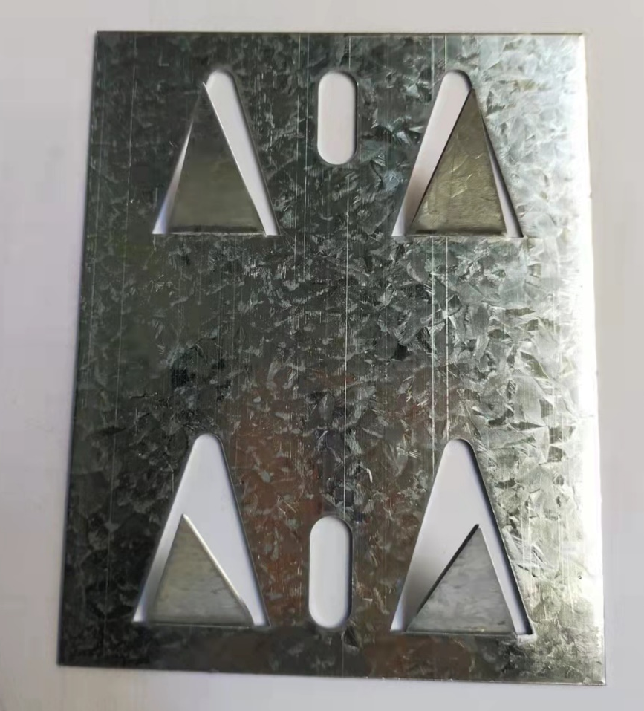
Large Impaling Clips M2, 3" x 4" x 3/4"
Impaling Clips simplify the installation of rigid fiberglass acoustic panels. Use screws to fasten the impaling clip to the surface, apply PolyFoam Adhesive on the clip and acoustic panel then press the fiberglass panel to the clip.
Product Features:
Item NO:TN1008001
Dimensions: 3" W x 4" L x 3/4" H
Material: Galvanized Steel
Design: 4-prong impaling clip with 2 mounting elliptical hole
Applications:
DIY acoustic panel installation
Fiberglass acoustical panels

Slide 8
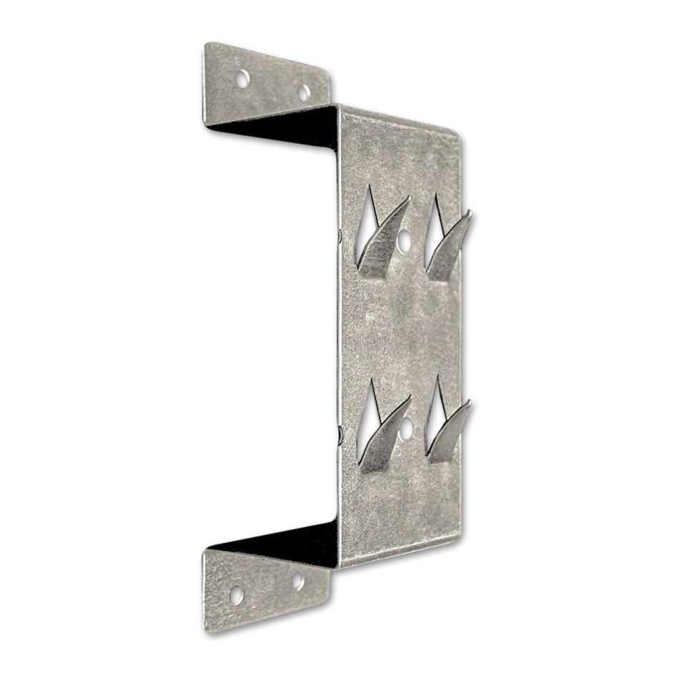
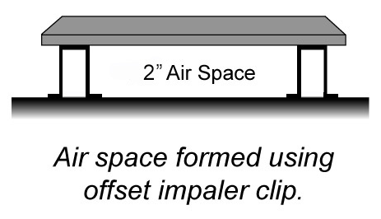
Offset Impaler-U Shaped
The Offset Impaler is designed to enhance the sound absorption performance of acoustic panels by creating a 2-inch air space between the panel and the mounting surface.
Its U-shaped design elevates the panel, forming an air cavity that can lower the effective absorption frequency by up to one octave.
The acoustic panels are held securely in place with sharp protruding darts that penetrate the panel backing.
For additional stability, a small amount of adhesive can be applied between the impaler face and the back of the panel.
Features
Quick and easy installation
Creates a 2″ air gap to improve sound absorption
Securely holds panels with sharp impaling darts
Technical Information
Item NO:TN170705001
Size: 6-3/4″ × 2-3/4″ × 2″ depth (nominal)
Material: Galvanized steel
Maximum Load: 12 lbs

Slide 9
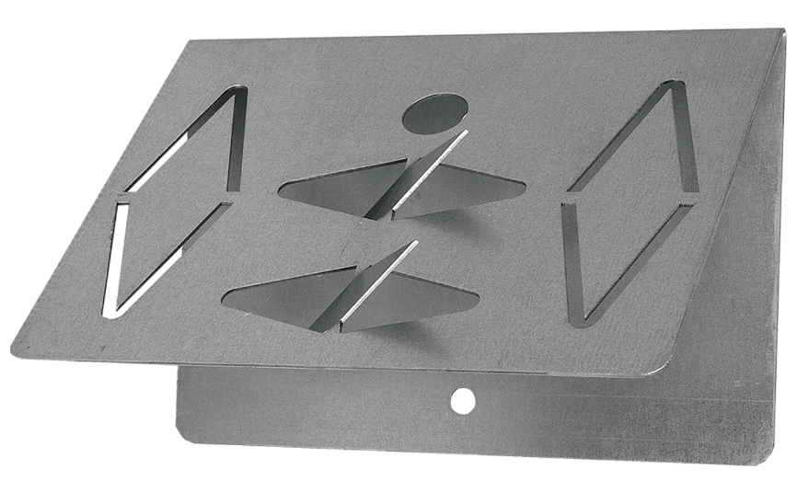
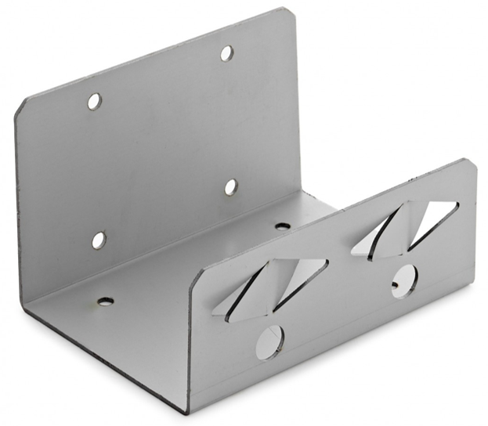
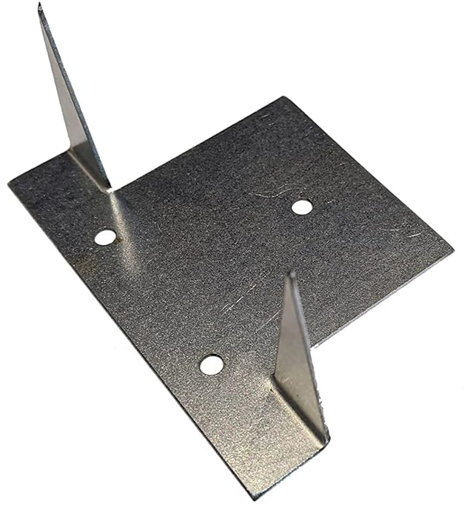
Customized By Requirement
Customized by your Drawing-Sample-Idea

